Slide 1
Association Rule Mining using GPU (Apriori Algorithm)
MALDAR AMAN
Notes:
You don’t need to know anything about GPUs for the first 6 out of 8 slides!

Slide 2
Association Rules
Introduction
Items that occur often together are associated with each other.
These together occuring items are called frequent itemset.
Examples of association rules
{Diaper} → {Beer}, {Milk, Bread} → {Diaper, Coke}, {Beer, Bread} → {Milk},
Notes:
Quick Introduction - Market Basket example . Milk and breads -> eggs
Other example – YouTube recommendation, website browsing
Advantage of this analysis is to make the products more accessible to user and generate more profit.

Slide 3
Association Rules (cont.)
Association Rule
An implication expression of the form X → Y, where X and Y are non-overlapping itemsets
Example: {Milk, Diaper} → {Beer}
Rule Evaluation Metrics
Support (s)‏
Fraction of transactions that contain both X and Y
Confidence (c)‏
Measures how often items in Y appear in transactions that contain X
Example:
See Slide Reference [1]
Notes:
3
Goal is to find all association rules that satisfy user-specified called as minimum support and minimum confidence threshold.
Support – How often a both the items occurs in the database. If you count .. Milk and diaper appears thrice. [milk, diaper, beer appears twice]
Confidence – How often item Y appears in the transaction that already contains X.
Question – How often beer appears in dataset when milk and diaper are already purchased?

Slide 4
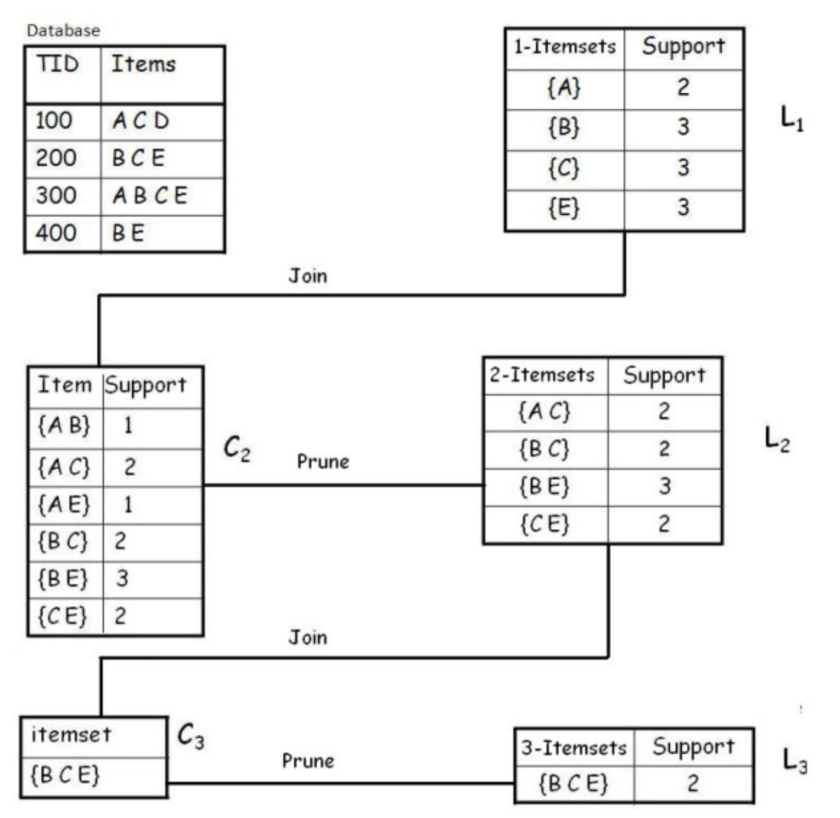
Analysis [2]
Notes:
Before going into pseudo algorithm I will run you through the steps involved in this algorithm.
TID is just a transaction number.
Apriori Property -
Itemset Generation – Itemset is not frequent if it’s subsets are not frequent. This is used in pruning. AB is not frequent and hence no point in generating its supersets.
Support = 2
Prune -
If you observed, we manually went through each transaction to calculate the number of occurrences. For M itemsets and N transactions, MN iterations are done.
The Apriori algorithm uses a same principle.
L1, L2 and L3 are our final datasets.

Slide 5
Apriori algorithm in pseudocode [1]
Identify Repetitive Functions
C_{k}: Candidate itemsets of size k, L_{k} : frequent itemsets of size k
L₁ = {frequent 1-itemsets};
for (k = 2; L_{k} != ∅; k++)
C_{k+1} = GenerateCandidates(L_{k})‏ // CPU / GPU ?
for each candidate in Ck, do // CPU / GPU ?
count the number of transactions in database containing a candidate (support for candidate)
endfor
L_{k+1} = candidates in C_{k+1} with support ≥min_sup /pruning CPU/GPU?
endfor
return ∪_{k} L_{k};
Notes:
Candidate generation is not compute intensive application and can be taken care by CPU.
--------------------------------------
It performs a level-wise search. In each iteration (line 2 to 10), firstly, a set of k candidates is generated by joining two frequent (k - 1)- itemsets if they share a common (k - 2)-prefix. A pruning procedure is invoked to eliminate any candidate which contains an infrequent subset; secondly, the support of every candidate itemset is counted by scanning the database. The It performs a level-wise search. In each iteration (line 2 to 10), firstly, a set of kcandidates is generated by joining two frequent (k - 1)- itemsets if they share a common (k - 2)-prefix. A pruning procedure is invoked to eliminate any candidate which contains an infrequent subset; secondly, the support of every candidate itemset is counted by scanning the database. The

Slide 6
Limitations of Approach
Bottlenecks and improvements
Uses a uniform minimum support threshold
Difficulties to find rarely occuring events
Some competing alternative approaches focus on partition and sampling
Bottlenecks
1) Candidate Generation depends on result of previous steps
2) Needs several iterations on the database to calculate support***
Notes:
This algorithm is computationally intensive due to multiple scans of the database in order to find the frequent itemsets.
It works efficiently for small databases whereas for large databases, due to its large size, its performance decreases.
So to increase its performance and to make it efficient even for the large databases, the algorithm is parallelized on GPU using CUDA
Candidate generation generates large numbers of subsets (the algorithm attempts to load up the candidate set with as many as possible before each scan)
BOTTLENECK 1) we cannot generate pair of three unless all the pair of two are pruned using Apriori property.

Slide 7
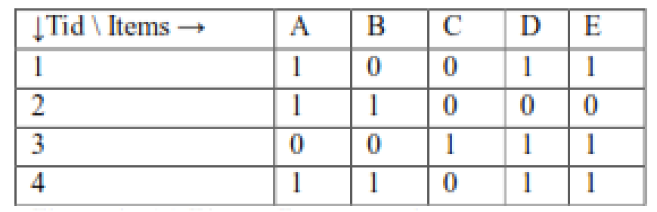
Proposed Strategy
Determining CPU and GPU Functions [3]
CPU converts the transaction details into BitMap representation to reduce memory
Candidate generation can be still done by CPU
Counting the number of occurrence of candidate in the given database using GPU (uses 1000s of threads)
Pruning of the itemset is done by CPU
Notes:
10000 TID, with each TID having 32 entries
- 4 Byte * 10000 = 40 Mb of database

Slide 8
Apriori algorithm in pseudocode [1]
Identify Repetitive Functions
C_{k}: Candidate itemsets of size k, L_{k} : frequent itemsets of size k
L₁ = {frequent 1-itemsets};
for (k = 2; L_{k} != ∅; k++)
C_{k+1} = GenerateCandidates(L_{k})‏ CPU*
for each candidate in Ck, do GPU*
count the number of transactions in database containing a candidate (support for candidate)
endfor
L_{k+1} = candidates in C_{k+1} with support ≥min_sup /pruning CPU*
endfor
return ∪_{k} L_{k};
Notes:
Candidate generation is not compute intensive application and can be taken care by CPU.
--------------------------------------
It performs a level-wise search.
In each iteration (line 2 to 10), firstly, a set of k candidates is generated by joining two frequent (k - 1)- itemsets if they share a common (k - 2)-prefix. A pruning procedure is invoked to eliminate any candidate which contains an infrequent subset; secondly, the support of every candidate itemset is counted by scanning the database. The It performs a level-wise search

Slide 9
Progress and Concerns
Progress
CPU version of the program is completed.
Measurement Metrics:
one_freq_itemset: 500
two_freq_itemset: 51532
three_freq_itemset: 33105
four_freq_itemset: 6644
Database Entries | Support | Time (Sec) | Memory
1000 | 0.001 | 0.650 | 2.61 MB
10000 | 0.0001 | 34 | 9.39 MB
20000 | 0.00005 | 138 | 11.96 MB
Notes:
Database entries =1000, 10000, 20000
Number of Entries in each transaction = 2, 3 or 4.
Confidence value = 0.5
Ref for memory usage: (Memory used by the process)
https://stackoverflow.com/questions/131303/how-to-measure-actual-memory-usage-of-an-application-or-process?utm_medium=organic&utm_source=google_rich_qa&utm_campaign=google_rich_qa
For original prog it is 8.52 MB max.

Slide 10
Progress and Concerns (cont…)
Concerns
Size of the shared memory is not sufficient
May need to partition the database
I have a kickstart by using small datasets.
Expected to deal with large size databases.

Slide 11
References
[1] cs-people.bu.edu/evimaria/cs565-12/lect2.pptx
[2] https://www.codeproject.com/articles/70371/apriori-algorithm
[3] Parallelizing Apriori Algorithm on GPU , K. Spandana, D. Sirisha, S. Shahida International Journal of Computer Applications (0975 – 8887) Volume 155 – No 10, December 2016

